Slide 1


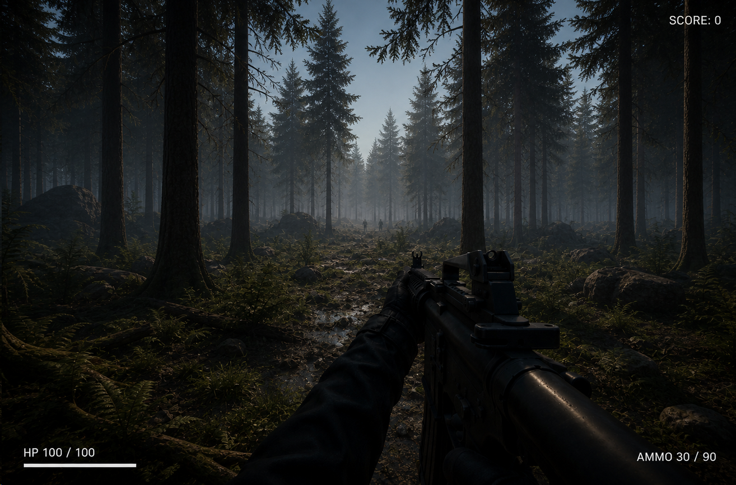
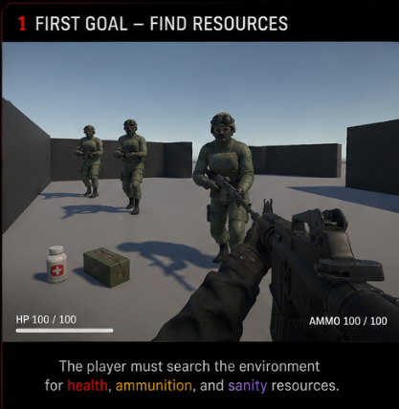



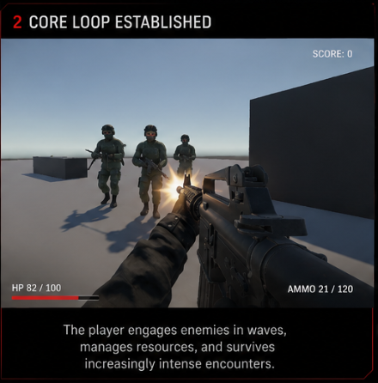
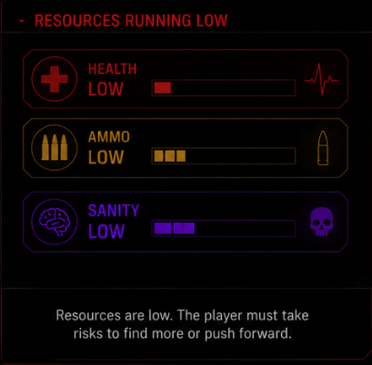
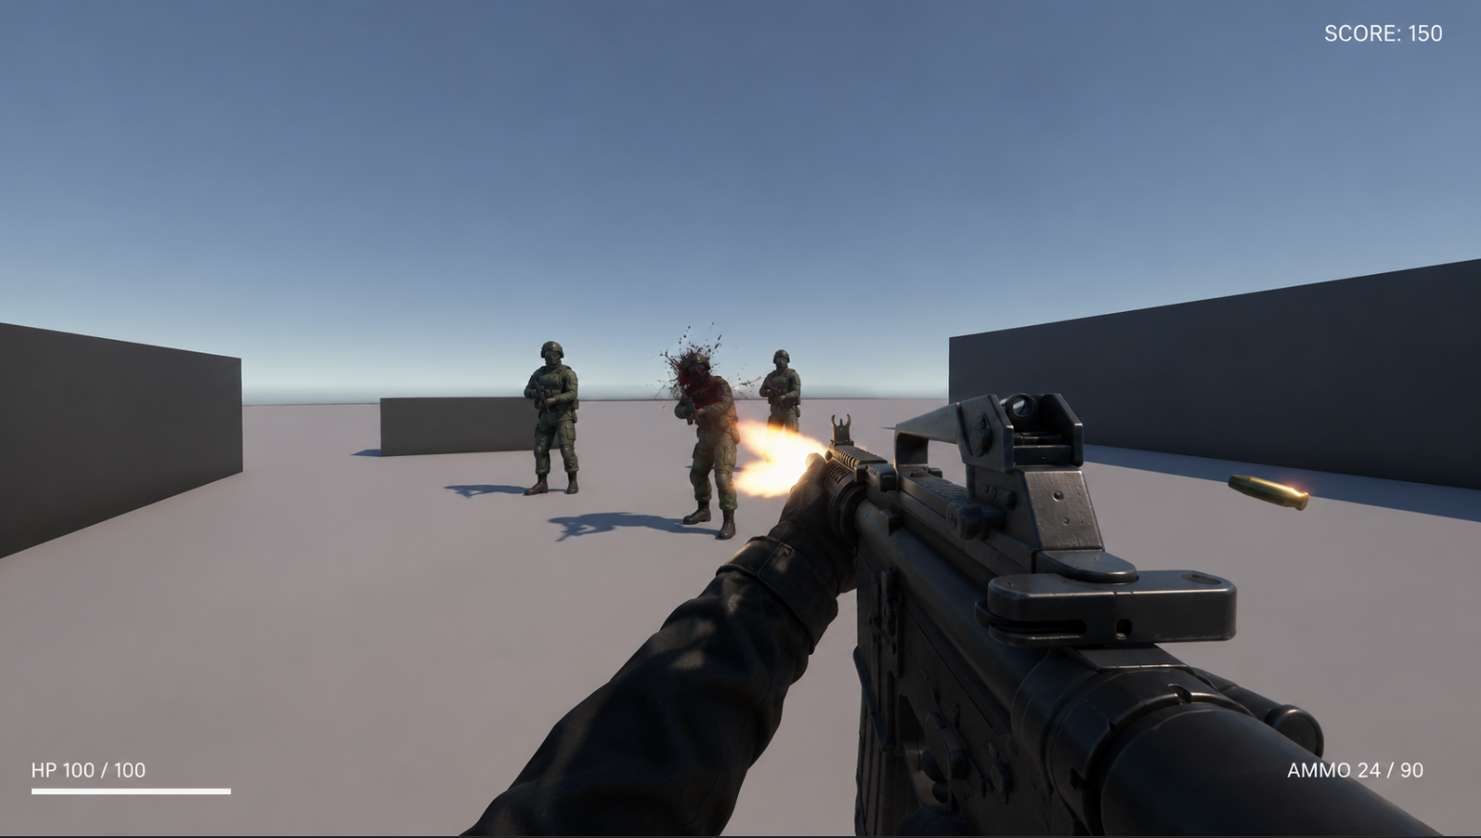
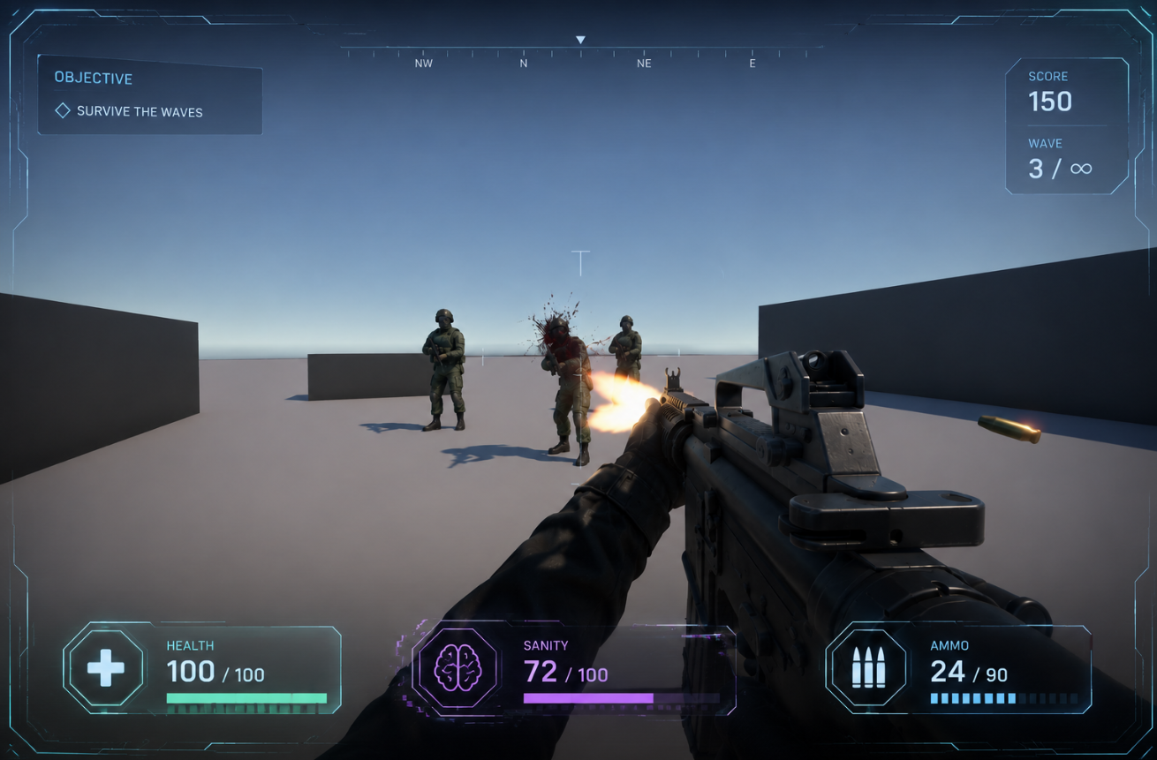

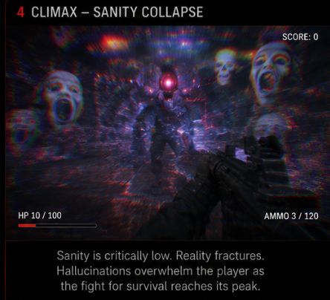
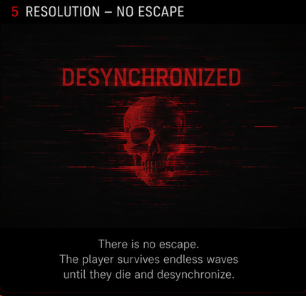

CS 4700 · GAME DESIGN STUDIO 4
SPRING 2026 · BRONCO GAME SHOWCASE
Exo Protocol
Your Game LOGO
A tactical survival FPS prototype focused on psychological pressure.
Survival FPS
First-Person
PC
01
CORE MECHANICS
02
STORYBOARD / FLOW
03
KEY ART & PILLARS
ICON
Combat
1
2
[ HERO SCREENSHOT / KEY ART ]
Fight hostile enemies while managing positioning, survival, and sustained firefights.
[ DROP STORYBOARD
IMAGE / SKETCH HERE ]
[ DROP STORYBOARD
IMAGE / SKETCH HERE ]
ICON
Adaptive AI
Enemy pressure escalates dynamically based on player performance and combat intensity.
ICON
3
4
Sanity System
[ DROP STORYBOARD
IMAGE / SKETCH HERE ]
[ DROP STORYBOARD
IMAGE / SKETCH HERE ]
Psychological effects distort the player’s vision and audio as sanity decreases.
[ GAMEPLAY GIF / SHOT ]
[ UI / HUD MOCKUP ]
ICON
Risk vs Survival
Aggressive combat increases tension while visual and audio hallucinations intensify.
5
6
[ DROP STORYBOARD
IMAGE / SKETCH HERE ]
[ DROP STORYBOARD
IMAGE / SKETCH HERE ]
DESIGN PILLARS
Adaptive combat pressure.
Paranoia and tension.
Dynamic sanity-driven visual and audio effects.
04
TECH STACK & PIPELINE
05
INNOVATIONS / CHALLENGES
Unity 6 LTS
C#
ProBuilder
FMOD 2.03
Blender
GitHub
We built an adaptive sanity and combat pressure system to maintain tension during firefights without making the game feel unfair. As enemy aggression increases, the player experiences escalating hallucination audio, visual distortion, chromatic instability, and temporary focus loss that simulate psychological stress during combat encounters. The system was designed to dynamically intensify pressure while still preserving player control and readability during high-intensity moments.
Engine
Language
Level Design
Audio
3D Assets
Version Control
THE TEAM
CAL POLY POMONA
PLAY THE BUILD
Eric Fierro
Michelle Reyes
Department of Computer Science
Game Design / Animations
Level Design / Programming
CS 4700 · Spring 2026 · Prof. Fatemeh Jamshidi
Brian Khuu
learn. prototype. ship.
Programming / Gameplay
https://github.com/ericmfierro/exo-protocol

